Slide 1
CCIS
(Climate Change IS _______ )
Kristen Chan
Julie Chung
Francisco Ochoa
Erik Chau
Brianda Gutierrez
Stephanie Ramos
Notes:
Kristen Chan – A11503613
Brianda Gutierrez – A10880554
Erik Chau – A99086834
Francisco Ochoa -- A12035504
Julie Chung – A12198485
Stephanie Ramos - A11254163

Slide 2
DESIGN PROBLEM

Slide 3

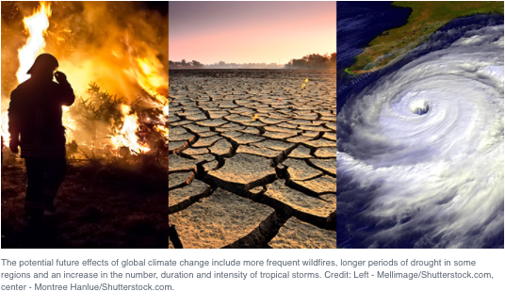
Lack of awareness on the causes and effects of climate change and how it negatively harms people and the globe
different levels of knowledge
Interviews conducted found that most feel somewhat knowledgeable on climate change issues, but do not feel directly affected by it

Slide 4
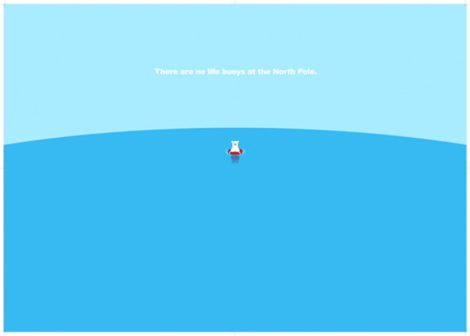
2010 study conducted by Yale Project on Climate Change Communication
Found that:
• 57% know that the greenhouse effect refers to gases in the atmosphere that trap heat;
• 50% of Americans understand that global warming is caused mostly by human activities;
• 45% understand that carbon dioxide traps heat from the Earth’s surface;
• 25% have ever heard of coral bleaching or ocean acidification
http://environment.yale.edu/climate-communication-OFF/files/ClimateChangeKnowledge2010.pdf

Slide 5
Social, Physical, and Conceptual Dimensions
Social Dimensions | Physical Dimensions | Conceptual Dimensions
Attractiveness/ Marketing | Number of students to be reached | Changing Consciousness to positively affect climate change
Current Political Climate | Size of UCSD Campus | Increasing lack of awareness for issue
Existing ideologies that negatively affect climate change | Respective homes of target audience | Climate change is affecting ecosystems and people

Slide 6
TARGET AUDIENCE

Slide 7
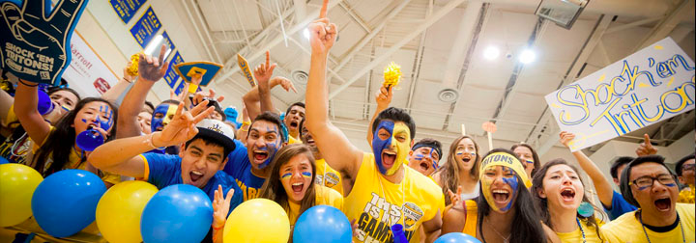
Target Audience
Approximately
35,816
UCSD Undergraduates
According to statistics from the 2016-2017 academic year
13,507 females
14,554 males
Students living both on and off campus
Notes:
So, for our target audience, we collected data from UCSD undergraduate students
According to statistics from the 2016-2017 school year, there are approximately 35,816 undergraduates split up into male and female demographics
And this included students living both on and off campus

Slide 8
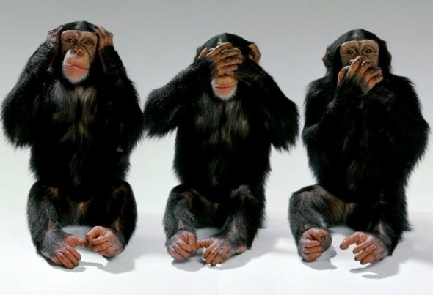

Psychographics & Tendencies
We operate on a very sensory-based level of experience, knowledge, and awareness
We can’t “see” it, so it’s not really an issue?
There is a natural social inclination for imitation and repetition amongst people that coexist in the same social atmospheres
“If everyone else is ignoring something, then so can I”
University students struggle with gauging how much of an impact climate change actually has on their lives, despite accepting that it exists
Education comes first!
Students are busy, and often inflexible
Notes:
In terms of psychographics and common tendencies:
We found that human beings operate on a very sensory level
So, the fact that we can’t actually “see” climate change is a key issue as to why it’s seen as a relatively invisible and harmless threat
There’s also a natural inclination for imitation and repetition
The idea of “If everyone else is ignoring something, then so can I”
Even though university students generally agree that climate change is real, most still don’t really think about it or understand how much it is affecting their lives
And most of all, education always comes first!
Because of busy and rigorous work schedules, students aren’t willing to be flexible with their time, beyond their predetermined routines and activities

Slide 9



Relevance
Students are our future!
“students also express their concern for the planet through green majors such as environmental science, sustainability and environmental policy” (Vendituoli)
The dimensions of a college student body are incredibly large and diverse
“college students represent a unique subset of the population because of their exposure to climate topics in school, recent exposure to catastrophic disaster events, and their position as future leaders and policymakers” (Phillips, et al.)
Notes:
In terms of relevance, university students were the ideal target audience.
First and foremost, students are our future!
They’re the ones who will use their current work to make differences later on, for everyone. Even though opinions vary across campuses, college students all have the ability to make a difference through their own lives
Undergraduates can now major in environmentally related fields, like environmental science, engineering, or policy
“students also express their concern for the planet through green majors such as environmental science, sustainability and environmental policy” (Vendituoli)
A college student body is very large and diverse
Public universities in the US are known for being pretty radically free and open-minded spaces
Students are exposed to a lot of different ideologies, standards, and even occupations
“college students represent a unique subset of the population because of their exposure to climate topics in school, recent exposure to catastrophic disaster events, and their position as future leaders and policymakers” (Phillips, et al.)

Slide 10
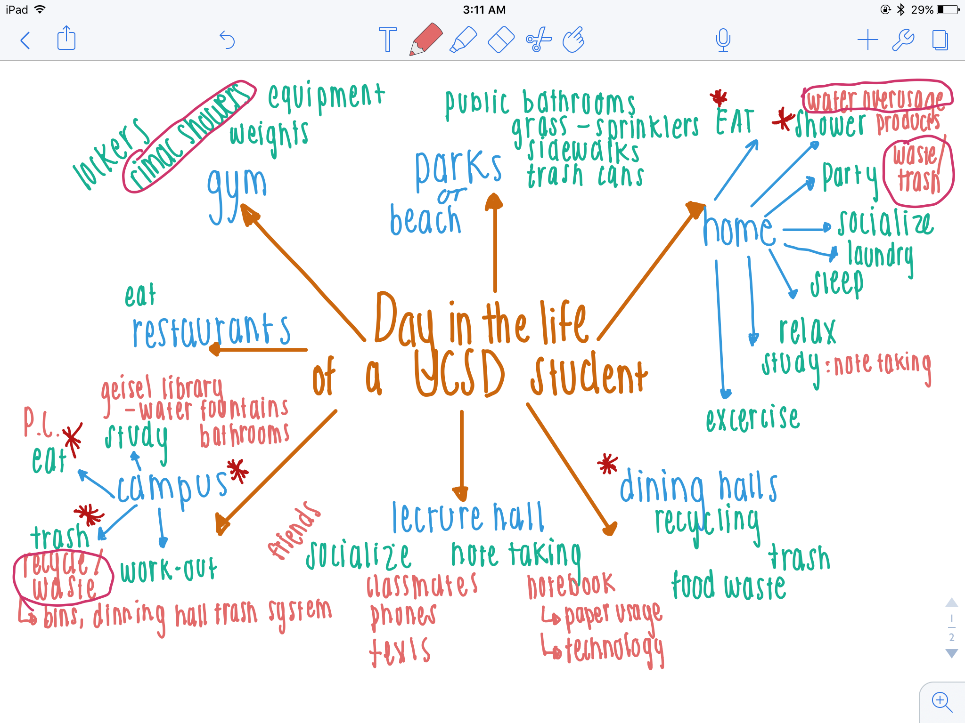
A Day In the Life of a UCSD Student
Our Day In the Life Model helped us seek areas of life where students form habits, informing our design development about practices in daily activity and where they could be improved, refined or eliminated.
Locations: lecture halls, dining halls, library, etc.
Could see our target problem to begin a solution design in accordance with these places, practices, devices and programs used or performed by UCSD students
Notes:
NEEDFINDING
Mapped certain locations of activities in blue.
Activities & devices converge from these spheres, allowing us to perceive where certain habits are practiced and where they could be improved, refined or eliminated
Places marked with asterisks in red are where we found practices that may instill poor climate change effects.

Slide 11
TESTING
&
SOLUTION

Slide 12
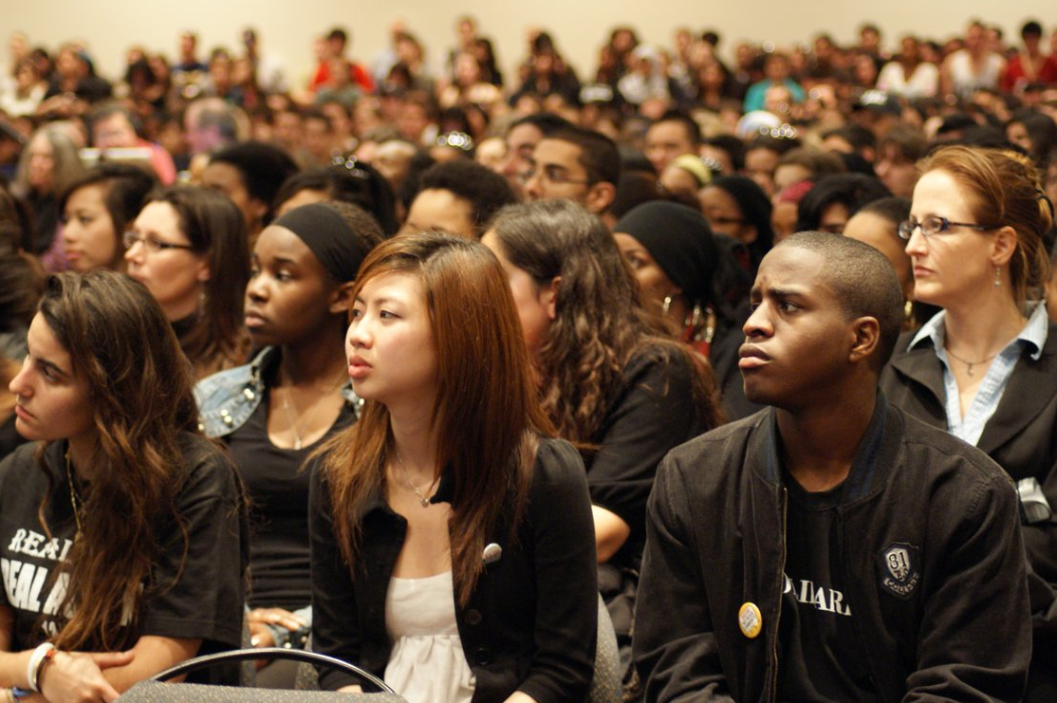
System
EDUCATIONAL
CULTURAL
ENGAGING
Notes:
Kristen
Because our target audience is students, we wanted to embed our prototype into campus life, specifically, something that could bring students together for a social and educational learning experience
This program would be self-sustaining and organic in that its own members would spread it by word of mouth.
Like other non-profit organizations this workshop would seek to educate students while also engaging in the culture of college life, something students would enjoy while also being beneficial to the climate

Slide 13
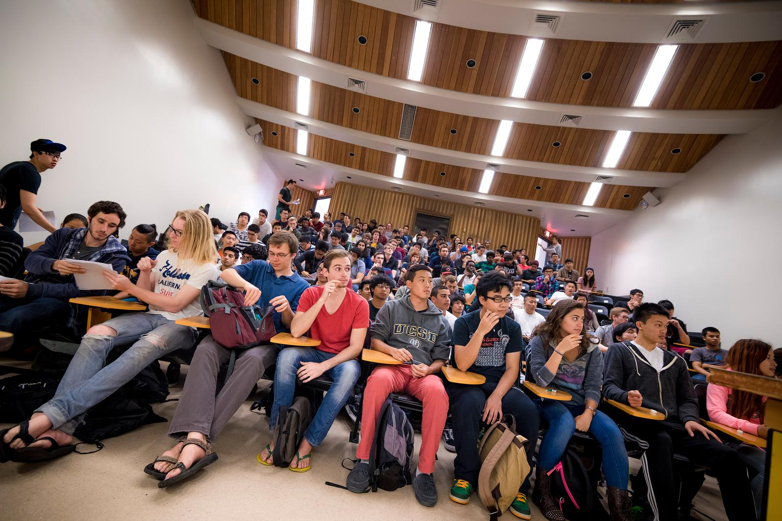
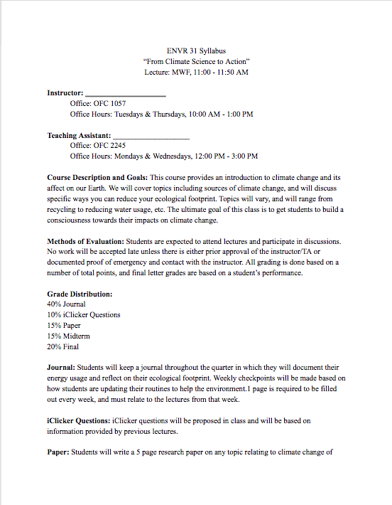
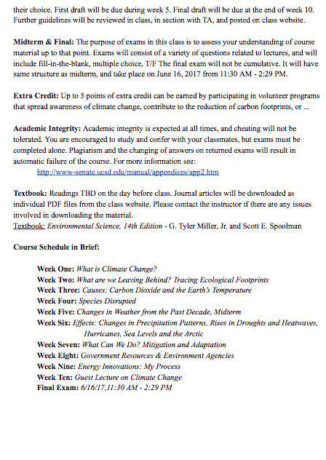
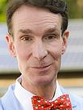
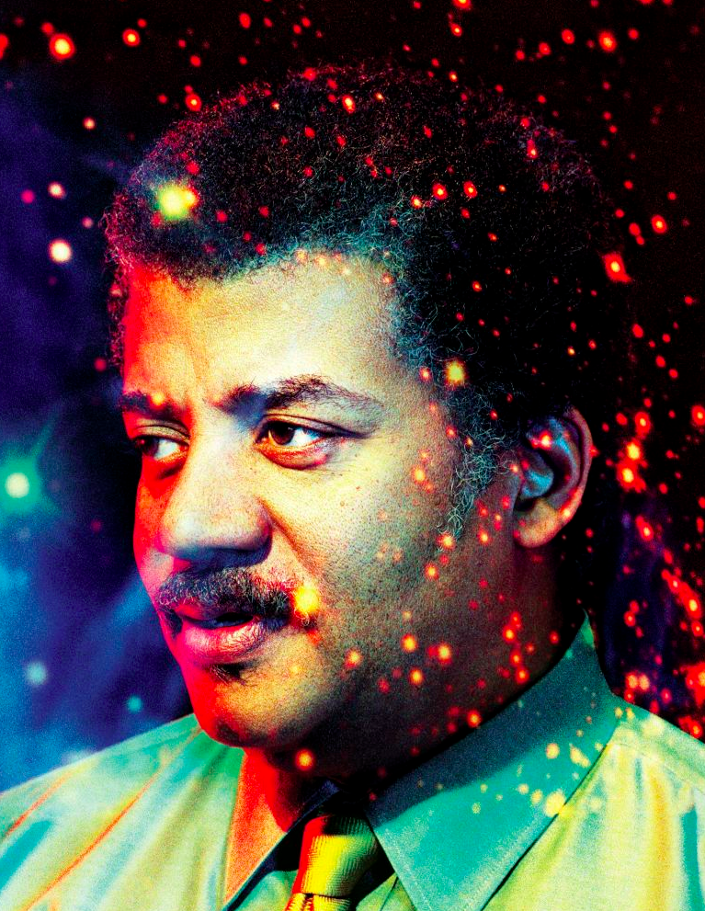
Prototype 1
Testing:
embodied student’s interests.
engagement, interaction and real-life experience
30 field studies
10 in-class studies
Maximize amount of students we could spread our agenda to
Decided on a required class
With guest lecturers such as:
Learn specifics about causes of climate change & what to do to reduce ecological footprint
Notes:
Through our findings that students were unknowledgeable on climate change, we decided on proposing a required class for all students to take in order to maximize spreading education on climate change. For our first prototype we set up a mock syllabus to present to testers. Testers gave us a lot of positive feed back on the structure of the class especially seeing that guest lecturers would be people like Bill Nye. We tested this syllabus with about 30 field studies and 10 in class studies. We asked students what we could do to make the class more appealing and many said that the grading distribution was a concern to them and that we should make it easier since it would be a required class. We also asked students if they would take the class if it were not a requirement and many said yes. That inspired our second prototype

Slide 14
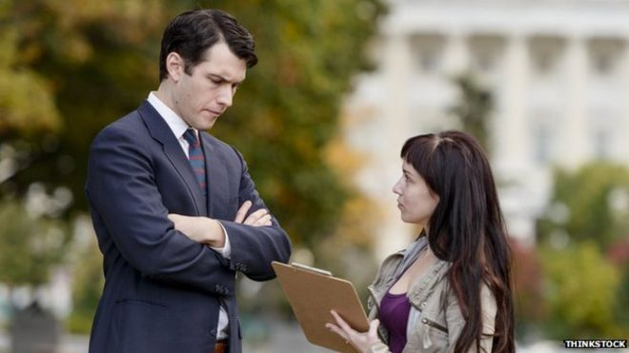
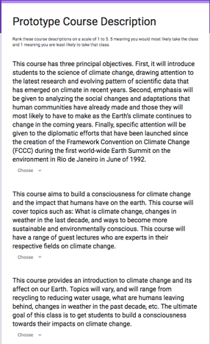
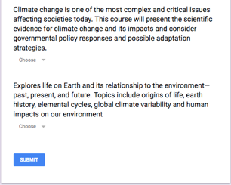
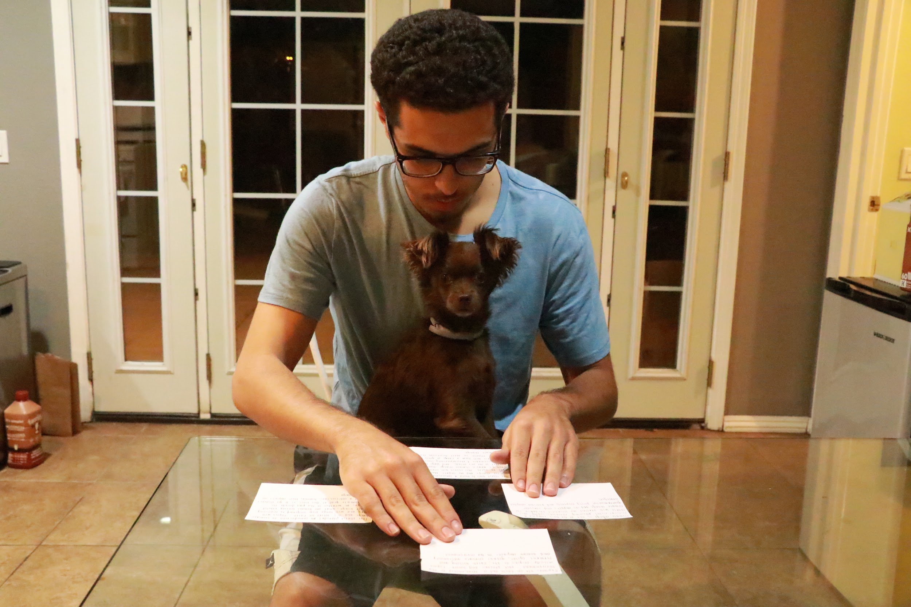
Prototype 2
Embodied student’s interests
Testers concerned about a required class, decided to stray away from distraction of grades
We asked testers to rank course descriptions from most to least interesting
Both online and in person
~50 online polls and ~30 field studies on UCSD
Testing: Presenting prototype to students and allowed them to interact with it privately.
Was more physically demanding than simply skimming through a mock syllabus.
Limitations: having students read more than preferred = inconsistent feedback.
Notes:
We decided to test whether students would
1st bullet point:
Decided to focus on the course description students would read when signing up for classes
wanted to make the course description as appealing as possible so we compared it to class related to climate change and other GE’s
2nd bullet point:
Unfortunately the task itself was not interesting and testers seemed to not take it seriously
Our course description was also hardly picked as most interesting

Slide 15
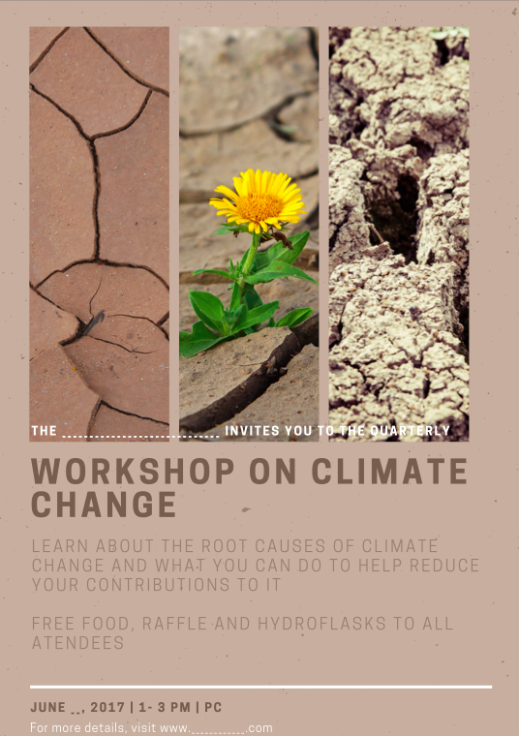
Final Prototype
Final Prototype: Quarterly workshop with iconic guest lecturers, food, raffles, and gifts!
Prototype 1: Students were concerned about grading distribution & having a required class
Prototype 2: Students would chose to take a different class to satisfy GE’s
Notes:
Reasons:
Through testing done, we learned that students prefer to take an easy class over taking a class for conservation, this was witness through multiple suggestions on altering our grade distribution to make it easier for students to fit into their hectic schedules. Although some testers said they would take the class for fun, hardly anyone chose
Testers of our prototype made it clear that unless the class was a requirement, they would not take the class if it were not easy to achieve an A.
Instead of scaring students into attending because they may or may not get an A, we understood that providing a relaxed and fun environment would be more effective to getting students to want to learn about climate change. We realized that an interactive course on climate change was too demanding especially since students already have hectic workloads. And although we would not get a turn out as large as threatening students with a grade, we would get students who want to make a change actually come to the workshop.Plus we would be bribing students to attend with food, meet and greet with iconic scientists and offer a hydroflask to everyone who stays till the end!

Slide 16



Competitive Analysis
UCSD SUSTAINABILITY RESOURCE CENTER
SCRIPPS INSTITUTE OF OCEANOGRAPHY
SIO 25
Notes:
Kristen
UCSD has a sustainability center whose mantra is zero waste by 2020. It has action buttons which urge students to lessen ecological footprint.
(Ideally this is what our prototype would reach towards, but we also wanted our solution to be more motivational, student run, and active.)
Under the oceanography institute, Scripps center for climate change impacts and adaptation: provides science-based strategies for adapting to climate change using research
SIO 25: Scripps class on climate change has a solid objective: that students will accurately and effectively relate information on climate change to a general public audience
Many of these features are useful tools but we saw that the best solution would be a combination of a class like sio 25 and the sustainability center, where students are willingly engaged in education and have a chance to make a difference with that knowledge

Slide 17
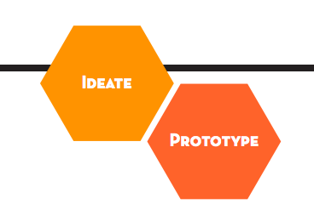
Findings through Texts
“Failure is an incredibly powerful tool for learning. Designing experiments, prototypes, and interactions and testing them is at the heart of human-centered design. So is an understanding that not all of them are going to work. As we seek to solve big problems, we’re bound to fail. But if we adopt the right mindset, we’ll inevitably learn something from that failure.” (21, IDEO Human-Centered Design)
“In order to avoid losing all of the innovation potential you have just generated through ideation, we recommend a process of considered selection, by which you bring multiple ideas forward into prototyping, thus maintaining your innovation potential” (4, DSchool Design Thinking)

